Slide 1
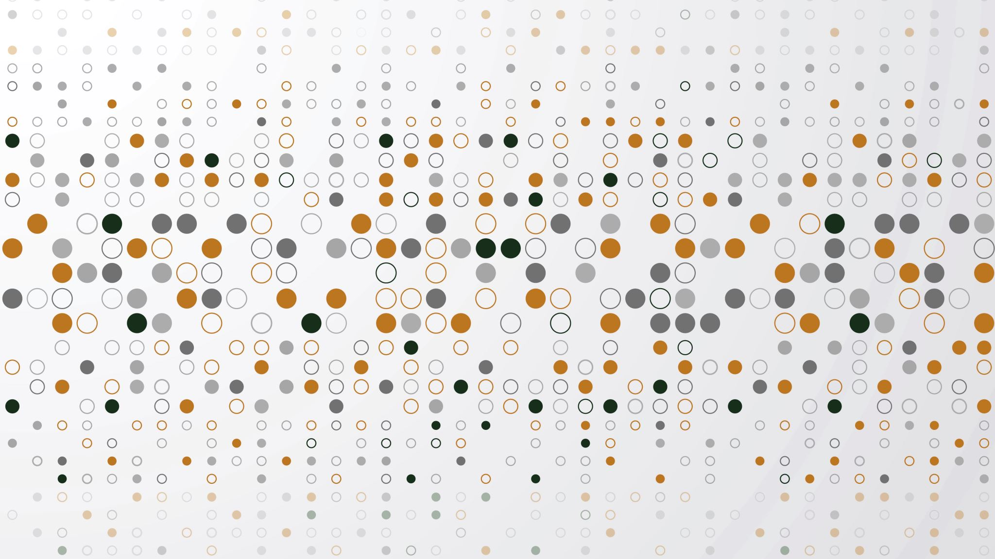
Machine Learning Models Based on Smartwatch Logs for Mental Health Predictions
Ambient Intelligence 2023/2024
Perfil 3
Vasco Oliveira a2019119011
Alexandre Costa a21280755

Slide 2
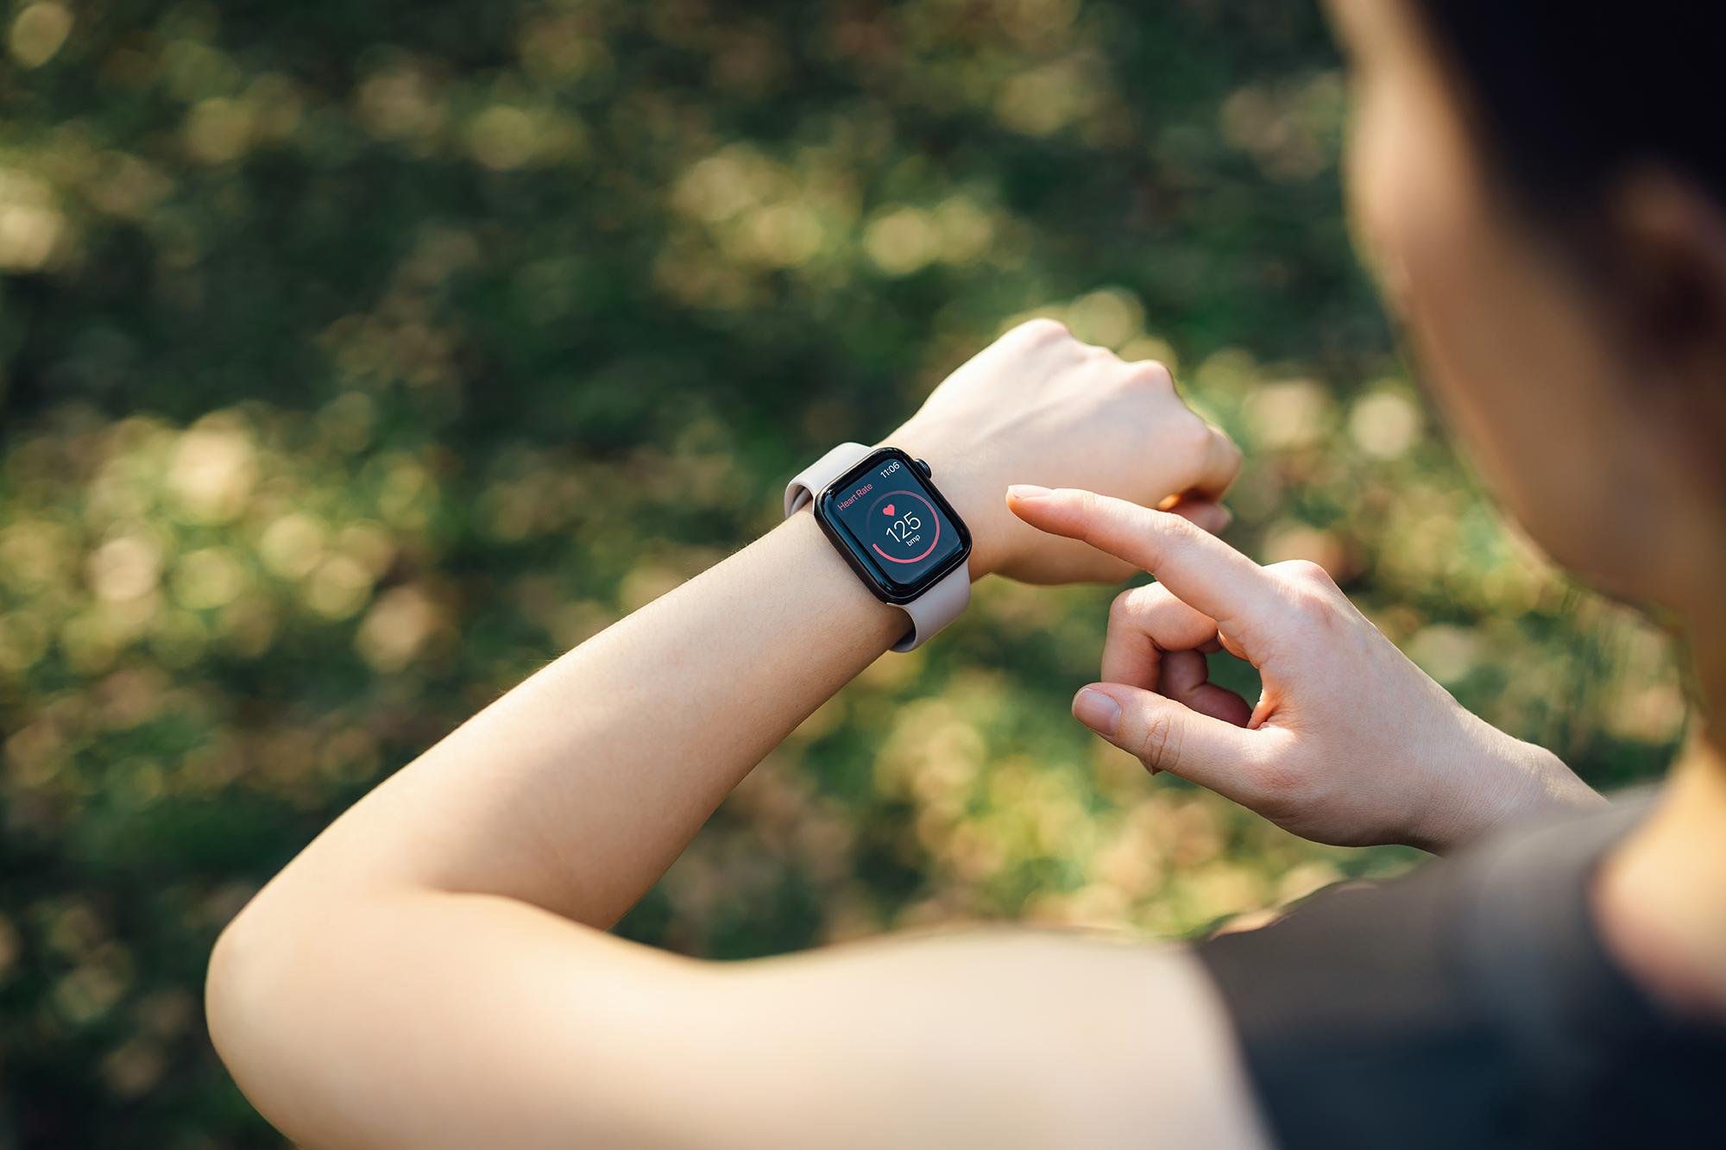
Index
Motivation
Objectives and Contributions
Related Work
Data Analysis
Utilized Sensors and Features
Data description and visualization
Data Processing
Machine Learning Models
Tests and Discussion
Data availability and privacy
Future work
Conclusions
Stages of the realized study

Slide 3
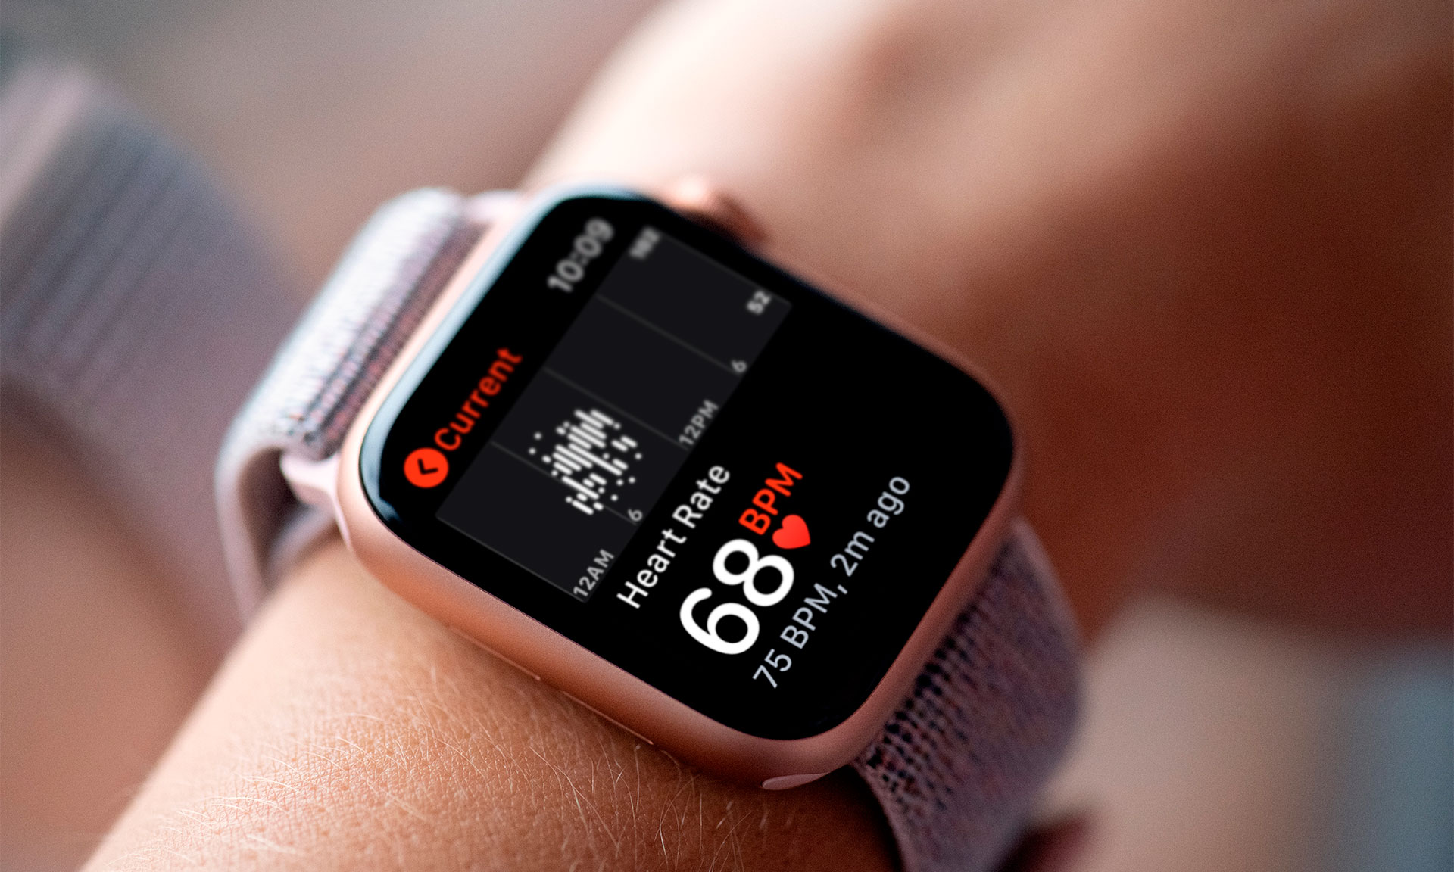
Motivation
The integration of machine learning algorithms with smartwatch data has emerged as a promising avenue for understanding and predicting various facets of human health.
Among these, stress prediction stands out as a critical area of interest, given the pervasive impact of stress on well-being and productivity. Leveraging the continuous stream of physiological and behavioral data captured by sensors present in common smartwatches, machine learning models offer unprecedented opportunities to discern patterns, identify triggers, and forecast stress levels in real-time.

Slide 4
Objectives and Contributions
What are the methods/signals that can be used to detect stress using a smartwatch?
What are the different Machine learning algorithms available that can be applied to detect stress prediction?
To find whether the accuracy of stress detection depends on the ML algorithm applied.
Which signal and ML algorithm combination gives the highest accuracy when detecting stress?
Our contribution relies on the usage of consumer grade smartwatches from different brands with sensors in common to try to predict stress.
We also focused solely on the heartrate sensors, to find the reliability in heartrate measurements to track stressed states.

Slide 5
Related Works
Mental Stress Prediction Using Wrist Wearable Through Machine Learning Approaches – In this paper traditional ML techniques are being used to predict the stress levels of a subject.
Machine Learning-based Approach for Predicting Health Information Using Smartwatch Data - In this paper traditional ML techniques are being used to obtain health information of a subject, using data generated by smartwatch sensors.
A Multi-Level Classification Approach for Sleep Stage Prediction With Processed Data Derived From Consumer Wearable Activity Trackers - This paper also covers traditional techniques applied to input data from wearable activity trackers, such as smartwatches.

Slide 6
Related Works
Stress Detection using Smartwatches with Machine Learning: A Survey – This paper analyzes different studies in the field of stress to find the best ML algorithms, as well as which sensors are most valuable in stress detection.
An Improved Approach for Stress Detection Using Physiological Signals- The use of neural networks for stress prediction using data from medical devices on the wrist and chest, although differing in the nature of the sensors, is useful to analyze the feature selection used as well as the processing related to the dataset used.

Slide 7
Data Analysis
Data was collected from a sample of participants who wore smartwatches equipped with sensors capable of measuring physiological signals like HRV(heart rate variation). Participants were asked to self-report their stress levels using established stress assessment scales.
After analysis, the collected data underwent preprocessing steps to clean and prepare it for analysis. This included removing outliers, selecting the features that would be compatible with the Apple Watch Series 5 and Samsung Galaxy Watch 5, and standardizing or normalizing the data to ensure consistency and comparability across different variables.

Slide 8
Data Analysis
We also conducted exploratory data analysis to gain insights into the characteristics of the collected data and identify potential patterns or trends related to stress levels. This involved visualizing the distributions of physiological signals, examining correlations between variables, and exploring differences in signal patterns between low and high-stress periods.
By using machine learning models based on the dataset we selected we used the collected data to get results regarding the subject's stress.

Slide 9
Utilized Sensors & Features
Age: Age of the subject, present in the fitness app;
Height: Height of the subject, present in the fitness app;
Weight: Weight of the subject, present in the fitness app;
Gender: Gender of the subject;
HR: Heart Rate in a certain moment of time, registered by manually triggering the measurement button or automatically with the smartwatch;
Condition: Dataset label, 0 if the subject was not under stress or 1 otherwise.

Slide 10
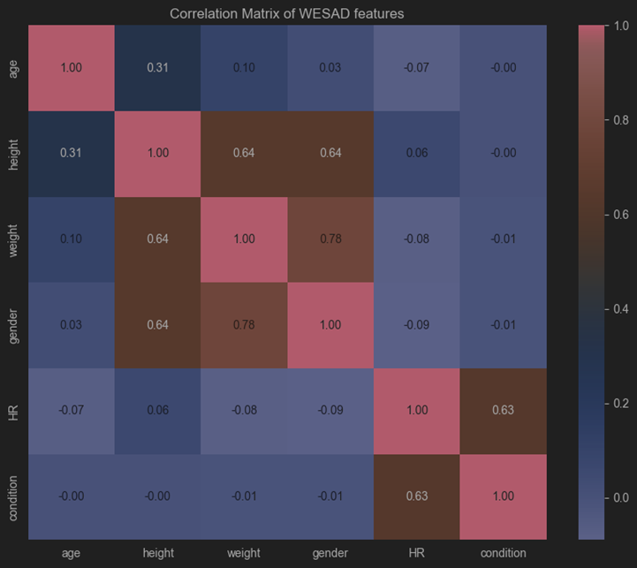
Data DESCRIPTION AND VISUALIZATION
Heatmap revealed that ‘HR’ showed a strong correlation between heartrate and stress detection.
We only selected features that we could replicate in our limited means by using our smartwatch devices.
From all the features present in the original dataset, we selected age, height, weight, gender and HR.
The measure to limit ourselves to heartrate variation was also done to demonstrate the impact of stress generating higher heart rate.

Slide 11
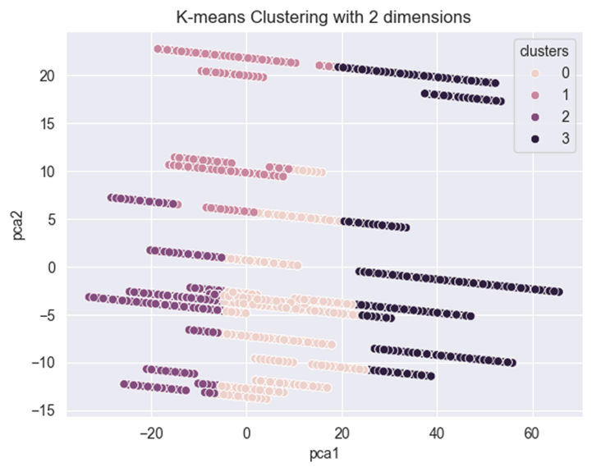
Data DESCRIPTION AND VISUALIZATION
The WESAD dataset utilized follows very specific limitations, given that it only uses measurements performed in 15 people with a close age gap as well as similar physical characteristics such as gender, weight and height.
This generates very limited results when it comes to generalization of data. Thousands of instances refer to a limited number of subjects. The shape of the data can be more easily perceived when analyzing K-means with 4 clusters.
KNN clustering was used to reduce the dimensionality of the data in a way to better represent the data utilized for training

Slide 12
Data processing
We normalized ‘condition’ and ‘gender’ using label encoder and transformed HR to an integer value.
We found the data to be imbalanced, having 94704 baseline instances and only 40946 stress instances, so we performed under sampling to achieve a ratio of 50/ stress instances and 50/ baseline instances.
In this study, we will try to detect when an individual is stressed, so we are applying binary classification to the following states: non-stress (0) and stress (1).

Slide 13
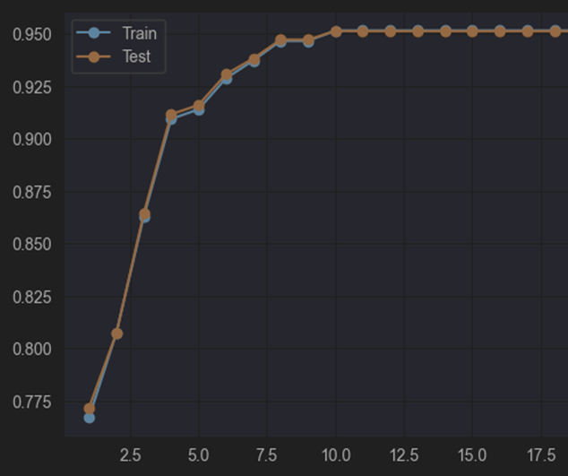
Machine Learning models
A Decision Tree Classifier with depth of 21 was used to analyze initial problems generating overfitting, leading us to graphs showing the learning process through iterations.
Two distinct Random Forest models were developed, one of them using cross validation to assess its generalizability, and the other model developed using Gridsearch to systematically explore the hyperparameter space of the random forest model and find the optimal combination that maximizes model performance.

Slide 14
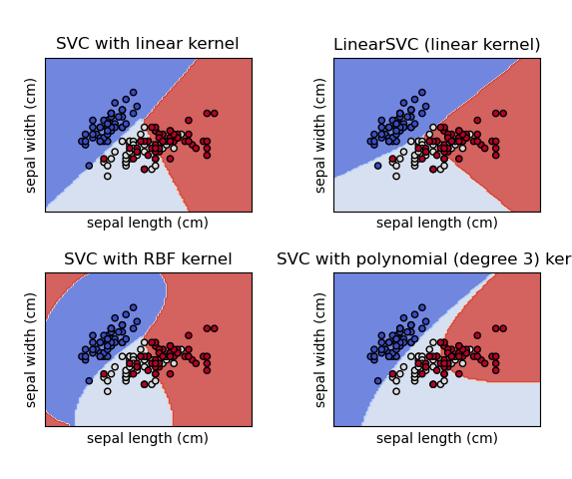
Machine Learning models
The Support Vector Machine model (SVM) was created using a linear kernel function, to find a linear hyperplane that best separates the two classes in the feature space.
The K-nearest-neighbors model (KNN) was developed using 3 neighbors, leveraging the similarity with its nearest neighbors in the feature space.
The Linear Discriminant Analysis (LDA) model was used for classification and dimensionality reduction, seeking to model the differences between the two classes by finding a linear combination of features that best separates multiple classes.

Slide 15
Machine Learning models
The best results were achieved by the model with Random Forest using Grid Search and the KNN model, and the worse results were generated by the LDA and SVM models.
Results might not be that accurate in handling real data; some of the utilized algorithms are better than others at gaining generalization from data with limited diversity, such as the SVM and Random Forest with cross validation.
We can be certain that the data utilized for training our models suffer from lack of diversity and will lead the models to suffer from weak of generalization.
Models | Accuracy | Precision | Recall | F1-score
Random Forest + Cross Validation | 0.90 | 0.92 | 0.92 | 0.91
Random Forest + GridSearch | 0.95 | 0.95 | 0.95 | 0.95
Support Vector Machine | 0.82 | 0.82 | 0.82 | 0.81
K-Nearest neighbors | 0.94 | 0.94 | 0.94 | 0.94
Linear Discriminant analysis | 0.81 | 0.81 | 0.81 | 0.79

Slide 16
Tests and Discussion
Age | Height | Weight | Gender | HR | Condition label | Random Forest Prediction GS | Random Forest Prediction CV | SVM_ Prediction | KNN_ Prediction | LDA_ Prediction
23 | 177 | 94 | 1 | 106 | 1 | 1 | 1 | 1 | 1 | 1
23 | 177 | 94 | 1 | 98 | 1 | 1 | 0 | 0 | 1 | 1
23 | 177 | 94 | 1 | 102 | 1 | 1 | 0 | 1 | 1 | 1
23 | 177 | 94 | 1 | 97 | 0 | 1 | 0 | 0 | 1 | 1
23 | 177 | 94 | 1 | 96 | 0 | 1 | 0 | 0 | 1 | 1
23 | 177 | 94 | 1 | 93 | 0 | 1 | 0 | 0 | 1 | 1
26 | 192 | 103 | 1 | 76 | 1 | 0 | 0 | 0 | 0 | 0
26 | 192 | 103 | 1 | 130 | 1 | 1 | 1 | 1 | 1 | 1
26 | 192 | 103 | 1 | 78 | 1 | 1 | 1 | 0 | 0 | 0
26 | 192 | 103 | 1 | 63 | 0 | 0 | 0 | 0 | 0 | 0
26 | 192 | 103 | 1 | 69 | 0 | 0 | 0 | 0 | 1 | 0
26 | 192 | 103 | 1 | 73 | 0 | 1 | 1 | 0 | 1 | 0
 |  |  |  |  |  | Fn=4 | Fn=3 | Fn=3 | Fn=1 | Fn=2
 |  |  |  |  |  | Fp=1 | Fp=1 | Fp=0 | Fp=5 | Fp=3
Assuming that false positives are worse in this medical adjacent scenario than false negatives, we can see that the SVM model performed the best at predicting stress using the collected data from the participants, the worse performing being the KNN model and LDA model.
The feature ‘condition label’ was manually inputted by the participants to represent weather they felt stressed or not.

Slide 17
Tests and Discussion
Age | Height | Weight | Gender | HR | Condition label | Random Forest Prediction GS | Random Forest Prediction CV | SVM_ Prediction | KNN_ Prediction | LDA_ Prediction
23 | 177 | 94 | 1 | 106 | 1 | 1 | 1 | 1 | 1 | 1
23 | 177 | 94 | 1 | 98 | 1 | 1 | 0 | 0 | 1 | 1
23 | 177 | 94 | 1 | 102 | 1 | 1 | 0 | 1 | 1 | 1
23 | 177 | 94 | 1 | 97 | 0 | 1 | 0 | 0 | 1 | 1
23 | 177 | 94 | 1 | 96 | 0 | 1 | 0 | 0 | 1 | 1
23 | 177 | 94 | 1 | 93 | 0 | 1 | 0 | 0 | 1 | 1
26 | 192 | 103 | 1 | 76 | 1 | 0 | 0 | 0 | 0 | 0
26 | 192 | 103 | 1 | 130 | 1 | 1 | 1 | 1 | 1 | 1
26 | 192 | 103 | 1 | 78 | 1 | 1 | 1 | 0 | 0 | 0
26 | 192 | 103 | 1 | 63 | 0 | 0 | 0 | 0 | 0 | 0
26 | 192 | 103 | 1 | 69 | 0 | 0 | 0 | 0 | 1 | 0
26 | 192 | 103 | 1 | 73 | 0 | 1 | 1 | 0 | 1 | 0
 |  |  |  |  |  | Fn=4 | Fn=3 | Fn=3 | Fn=1 | Fn=2
 |  |  |  |  |  | Fp=1 | Fp=1 | Fp=0 | Fp=5 | Fp=3
All the models correctly predicted stress on the instance of one of the subjects scratching his car before a job interview, noticing the accelerated heartrate in the moment. However, to detect stress in less extreme situations, they showed worse performance.
The models generally found hard to predict stress in the participant with higher heart rate than normal, as the subject’s data used for training, usually displayed less elevated heartrates.

Slide 18
Tests and Discussion
Age | Height | Weight | Gender | HR | Condition label | Random Forest Prediction GS | Random Forest Prediction CV | SVM_ Prediction | KNN_ Prediction | LDA_ Prediction
23 | 177 | 94 | 1 | 106 | 1 | 1 | 1 | 1 | 1 | 1
23 | 177 | 94 | 1 | 98 | 1 | 1 | 0 | 0 | 1 | 1
23 | 177 | 94 | 1 | 102 | 1 | 1 | 0 | 1 | 1 | 1
23 | 177 | 94 | 1 | 97 | 0 | 1 | 0 | 0 | 1 | 1
23 | 177 | 94 | 1 | 96 | 0 | 1 | 0 | 0 | 1 | 1
23 | 177 | 94 | 1 | 93 | 0 | 1 | 0 | 0 | 1 | 1
26 | 192 | 103 | 1 | 76 | 1 | 0 | 0 | 0 | 0 | 0
26 | 192 | 103 | 1 | 130 | 1 | 1 | 1 | 1 | 1 | 1
26 | 192 | 103 | 1 | 78 | 1 | 1 | 1 | 0 | 0 | 0
26 | 192 | 103 | 1 | 63 | 0 | 0 | 0 | 0 | 0 | 0
26 | 192 | 103 | 1 | 69 | 0 | 0 | 0 | 0 | 1 | 0
26 | 192 | 103 | 1 | 73 | 0 | 1 | 1 | 0 | 1 | 0
 |  |  |  |  |  | Fn=4 | Fn=3 | Fn=3 | Fn=1 | Fn=2
 |  |  |  |  |  | Fp=1 | Fp=1 | Fp=0 | Fp=5 | Fp=3
Random Forest model with cross validation showed better accuracy than the one that utilized grid search, despite showing better results in the metrics. Leading us to believe that in this scenario using cross validation to increase generalization is better than trying to find the optimal parameters for training Random Forest models.

Slide 19
Data availability and privacy
The process of capturing data started in April 2024 and ended in June of the same year. It was deemed sufficient as it was only required to get some instances relating to stressed states and non-stress states. To ensure data accuracy, participants were advised to maintain the smartwatch's optical heart rate sensor clean and in proper contact with their skin. Additionally, they were encouraged to engage in their typical daily activities, providing a realistic representation of their heart rate patterns.
The subjects were also asked to take some notes of key moments where the stress was more noticeable and manually trigger their smartwatches to register the Heart Rate. This way it was possible to add the condition label and compare the accuracy of the trained models.

Slide 20
Data availability and privacy
Typical stress states involve activities such as university exams, job interviews and one instance of scratching a car. Non stress states relate to calmer events, such as relaxing at home reading a book or playing casual games on a game console.
Since the measurements were done using the Apple Watch Series 5 and the Samsung Galaxy Watch 5, the data was extracted through their respective fitness/health apps and manually prepared to ensure only the required data was being used, while also having the consent of the subjects to do so.
Finally, to ensure privacy was maintained there was secure raw data disposal at the study's conclusion, as well as using no identifiable features in data utilized for testing using real data.

Slide 21
Future Work
Using a machine learning algorithm that considers the proximity between points of temporal data will offer better results, by example using the Long Short-Term Memory algorithm.
Use of a more diverse dataset leading to models with higher generalization, such as having more individuals in the dataset with broader distinctions between themselves.
Pursue other features to predict stress, such as EDA, BVP and skin temperature, as proven by the analysed papers these showed themselves to be relevant for stress detection [5],[3],[4].
Ideally, models trained with a broader range of values and the inclusion of more features derived from more sensors available in smartwatches would provide much more accurate results.

Slide 22
Conclusions
Through comprehensive data preprocessing, feature selection, and model training, we have successfully leveraged various algorithms to identify patterns indicative of stress using heartrate measurements. Our findings indicate that machine learning models, particularly Random Forest with cross validation and Support Vector Classifier, exhibit high accuracy and robustness in distinguishing between stressed and non-stressed states.
Despite the developed models’ limitations, it is possible to predict stress using measured heart rate. The best performing model when utilizing real data was the SVM one, predicting no false positives and only 3 false negatives, essentially having an accuracy of 75% when tested with our collected data.

Slide 23
Stages of the realized study
Analysis of related works.
Dataset selection.
Feature selection and inference.
Model creation.
Gathering of participant data.
Test and analysis of results.

Slide 24
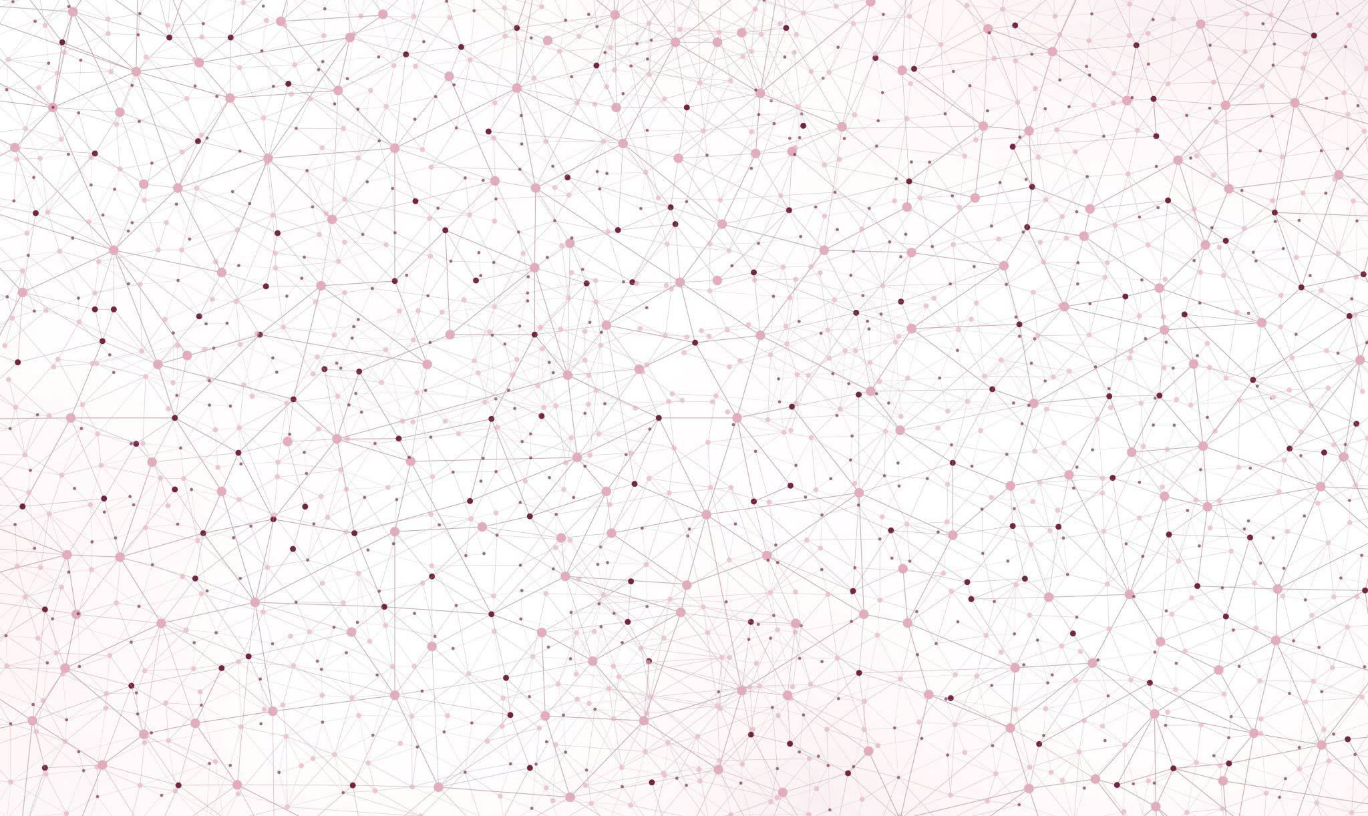
DISCUSSION

Slide 25
References
[1] K. Nigam, K. Godani, D. Sharma, and S. Jain, “An Improved Approach for Stress Detection Using Physiological Signals,” EAI Endorsed Transactions on Scalable Information Systems, vol. “8,” no. 33, May 2021, doi: 10.4108/EAI.14-5-2021.169919.
[2] L. Zhu et al., “Feasibility Study of Stress Detection with Machine Learning through EDA from Wearable Devices,” IEEE International Conference on Communications, vol. 2022-May, pp. 4800–4805, 2022, doi: 10.1109/ICC45855.2022.9838970.
[3] P. Siirtola, “Continuous stress detection using the sensors of commercial smartwatch,” UbiComp/ISWC 2019- - Adjunct Proceedings of the 2019 ACM International Joint Conference on Pervasive and Ubiquitous Computing and Proceedings of the 2019 ACM International Symposium on Wearable Computers, pp. 1198–1201, Sep. 2019, doi: 10.1145/3341162.3344831.
[4] P. Verma and R. Singh, “Mental Stress Prediction Using Wrist Wearable Through Machine Learning Approaches,” 2023 International Conference on Sustainable Emerging Innovations in Engineering and Technology, ICSEIET 2023, pp. 475–481, 2023, doi: 10.1109/ICSEIET58677.2023.10303348.
[5] R. Katarya and S. Maan, “Stress Detection using Smartwatches with Machine Learning: A Survey,” Proceedings of the International Conference on Electronics and Sustainable Communication Systems, ICESC 2020, pp. 306–310, Jul. 2020, doi: 10.1109/ICESC48915.2020.9155568.
[6] V. R. Chifu, C. Bianca Pop, A. Ciurianu, E. S. Chifu, and M. Antal, “Machine Learning-based Approach for Predicting Health Information Using Smartwatch Data,” Proceedings - 2021 IEEE 17th International Conference on Intelligent Computer Communication and Processing, ICCP 2021, pp. 391–397, 2021, doi: 10.1109/ICCP53602.2021.9733559.
[7] “Biometrics for stress monitoring.” Accessed: Jun. 20, 2024. [Online]. Available: https://www.kaggle.com/datasets/qiriro/stress
[8] “WESAD: Multimodal Dataset for Wearable Stress and Affect Detection | Ubiquitous Computing.” Accessed: Jun. 19, 2024. [Online]. Available: https://ubicomp.eti.uni-siegen.de/home/datasets/icmi18/
[9] “classification_report — scikit-learn 1.5.0 documentation.” Accessed: Jun. 20, 2024. [Online]. Available: https://scikit-learn.org/stable/modules/generated/sklearn.metrics.classification_report.html

